Slide 1
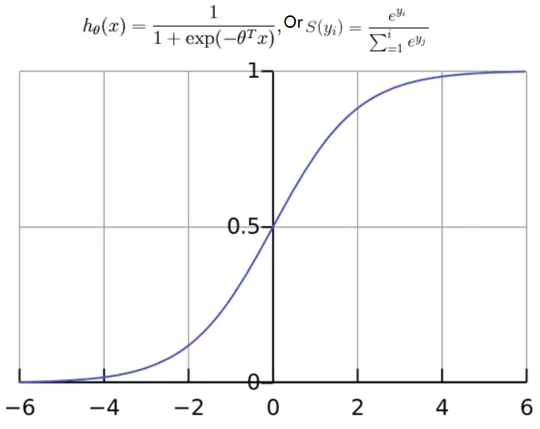

Softmax
(output)
Cross Entropy
(Loss function)

Slide 2
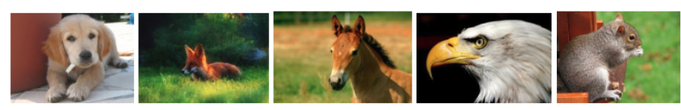
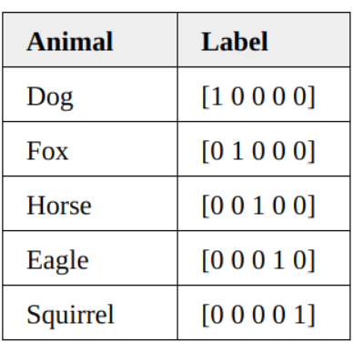
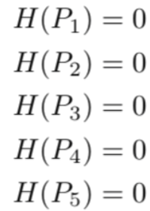
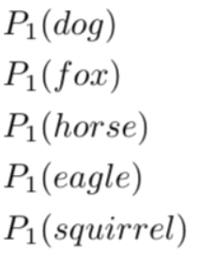

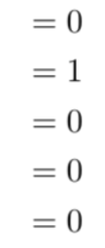

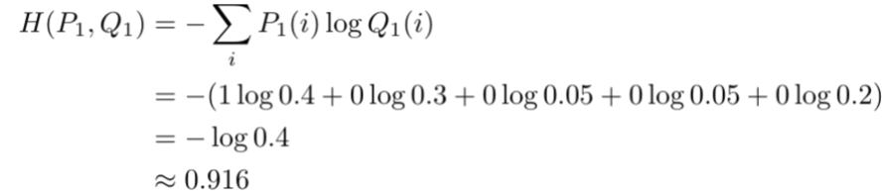

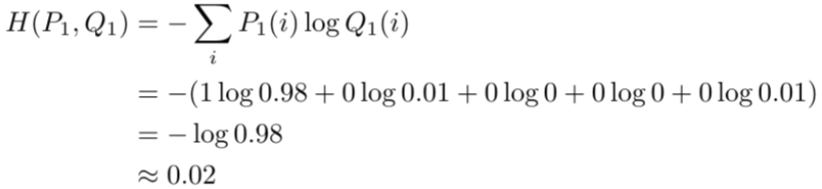
…
1. Probability
1.
the first image is
40% for a dog,
30% for a fox,
5% for a horse,
5% for an eagle
20% for a squirrel.
calculate the cross-entropy
- Higher than the 0 entropy of the label;
- we do not have an intuitive sense
of what this value means.
2. Label
1. Probability
cross-entropy goes down
as the prediction gets more accurate.
- becomes 0 if the prediction is perfect.
2. Label

